Slide 1
Status from Martin Josefsson
Hardware level performance of 82599
Bifrost Workshop 2010
d.27/1-2010
Testlab and Data provide
by Martin Josefsson
Procera Networks
by
Jesper Dangaard Brouer <jdb@comx.dk>
Master of Computer Science
ComX Networks A/S

Slide 2
Background
Martin Josefsson (aka Gandalf)
  Could not attend Bifrost Workshop 2010
    Thus, I'm giving a resume of his findings
Tried to determine
  the hardware performance limits of the 82599 chip
  Found some chipset limitation
Hardware shows (82599 + Nehalem)
  Very close to wirespeed forwarding capabilities
    But partial cacheline PCIe transfers drops perf

Slide 3
Test setup
Dell R710:
CPU 1 x E5520
  4 cores 2.26GHz, QPI 5.86GT/s, 1066MHz DDR3
  Hyperthreading enabled improve by ~20%.
NIC: 2 x Intel X520-DA: 2 port
  single 82599ES, using pci-e x8 gen2
Traffic generator:
  Smartbits with two 10GE modules.

Slide 4
Operating System: PLOS
PLOS – is Procera Networks owns OS
  1 thread runs Linux, 7 threads run PLOS
small standalone kernel
  designed for packet processing only (no userspace)
uses a channel concept
  each channel, assigned two interfaces
  packets are forwarded between the interfaces
  giving a 1:1 mapping of RX and TX interfaces
  (details in bonus slides)

Slide 5
Dumb forwarding: HW level
Test results/setup
  Very dumb forwarding of packets
  Purpose: find the hardware limits
  The packet data is not even touched by the CPUs
Tests are bidirectional
Results counts
  Forwarded TX packets per sec
  From both interfaces

Slide 6
Test results
Two tests
  One NIC: Using two ports on one dual port NIC
  Two NICS: Using two NICs on port on each

Slide 7
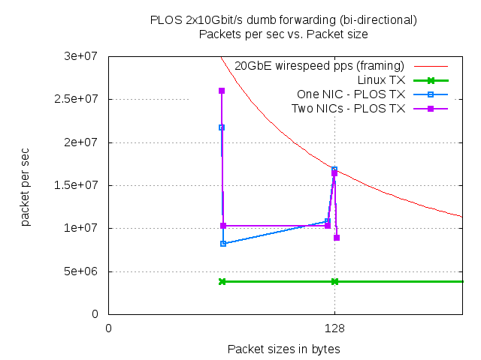
Test results: Graph

Slide 8
Issue: Partial cacheline PCIe
The cause of the performance hit:
According to Intel there is an
  issue with partial cacheline pci-e
  transfers in the Tylersburg (X58, 5500, 5520) chipset.
Each partial cacheline transfer
  uses one outstanding pci-e transfer
  and one outstanding QPI transfer.

Slide 9
Workaround?
No solution at the moment to this issue :(
A possible workaround
  get the 82599 to pad pci-e transfers
  to a multiple of the cacheline size
  but unfortunately it doesn't have this capability

Slide 10
Close to Wirespeed
A single port on an 82599
  Can't RX more than around 13.8 Mpps at 64 bytes
    Intel verified this
  Ethernet wirespeed is 14.8 Mpps at 64 bytes
Which I find quite impressive
  Also compared to other 10GbE NICs
  And compared to peek 5.7 Mpps by Linux

Slide 11
Conclusion
The Nehalem architecture
  a massive improvement over the old Intel arch
  still issues that impacts performance greatly
The 82599 NIC
  Comes very close to wirespeed
    Parial cacheline PCI-e hurts badly!
  Numbers are still impressive
    compared to Linux
      room for optimizations!

Slide 12
Bonus slides
After this slide is some bonus slides
  With extra details...

Slide 13
Bonus#1: locking of RX queue
Each interface
  a single RX-queue and 7 TX-queues in tests
Each PLOS thread locks the RX-queue
  grabs a bunch of packets,
  unlocks the RX-queue lock
  forwards the packets
    to one of the TX-queues of the destination interface

Slide 14
Bonus#2: locking of RX queue
RX is serialized by a spin-lock (or trylock)
  threads continue to try to lock the next interface
    RX-queue if the current one is already locked
This is clearly not optimal
  RSS and DCA will be investigated in the future.
TX is not serialized
  but cases where serializing TX actually helps

Slide 15
Strange PCIe x4 experience
Seems, get higher performance
  with none cacheline sized packets
  when the 82599 is running at pci-e 4x gen2.
Channel with 2 ports on the same 82599ES:
  pci-e x8 and 65 byte packets: 8.2 Mpps
  pci-e x4 and 65 byte packets: 11.2 Mpps
  I can't explain this, feels like this could have something
  to do with either pci-e latency
  or with how many outstanding pci-e transfers
    BIOS has configured for the pci-e port

